Slide 1


Super Store Sales Analysis with Python and Power BI
About the project
E-commerce has become a cornerstone of the global economy, with millions of transactions occurring daily across various platforms. The vast amount of data generated by online stores presents significant opportunities for businesses to gain valuable insights into customer behavior, sales performance, and market trends. This project focuses on analyzing e-commerce data to uncover patterns, identify key metrics, and provide actionable insights that can inform decision-making and drive business growth.
Objective
The objective of this project is to conduct an Exploratory Data Analysis (EDA) using Python, a powerful tool for data manipulation, visualization, and analysis. Through EDA, we will examine the underlying structure and characteristics of the data, identify potential trends, detect outliers, and uncover relationships between different variables. This analysis will enable a better understanding of factors like customer purchasing behavior, product performance, and seasonal trends.

Slide 2
Problem
Calculate the monthly Sales of the store and identify which month had the highest sales and which month had the lowest Sales.
Analyse Sales based on Product Category and determine which Category had the lowest Sales and which Category had the highest Sales.
Sales Analysis Based on Sub Category
Analyse the monthly Profit From Sales and determine which month had the Highest profit and which month had the lowest profit .
Analyse Profit by Category and Sub-Category
Analyse Sales and Profit by Customer Segmentation
Analyse the Sales to Profit Ratio
Which Sales team had the highest customer?
What are the top 5 Products sold?
. Which State had the highest product order rate?
Which State generated the highest sales?
Which region and product category contributed most to sales?
Which quarter had the highest sales?
How do Sales and Profit carry overtime across region and state?
What is the correlation between sales revenue, cost, and profit for each year, indicating whether sales increased or decreased over time?

Slide 3
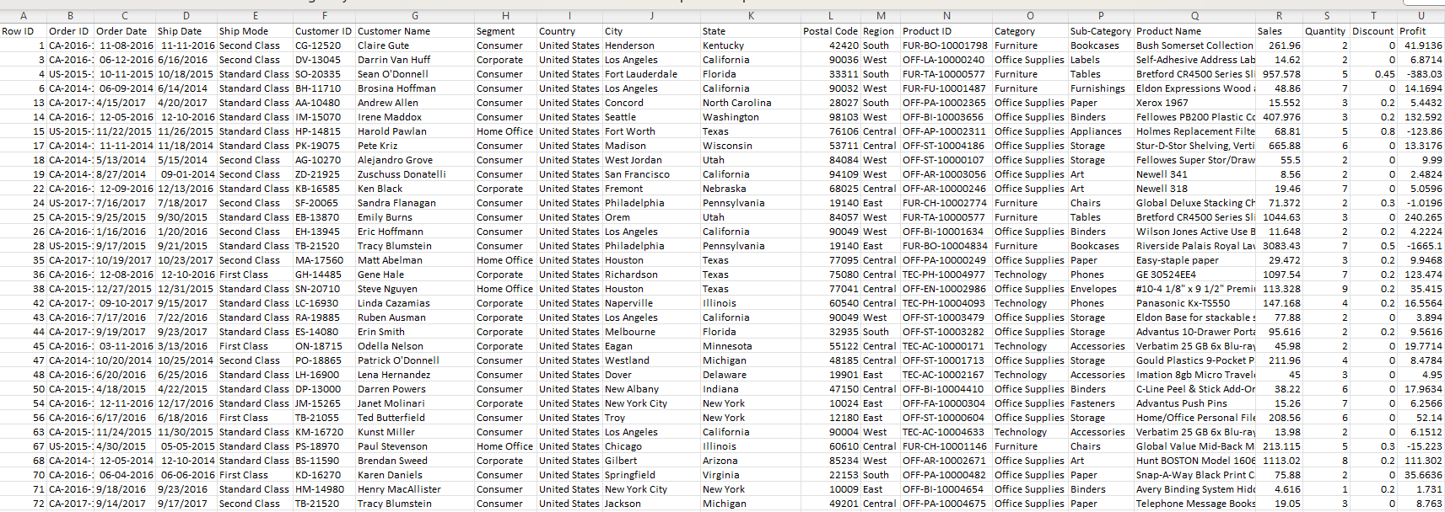
About the data
The data set has:

Slide 4
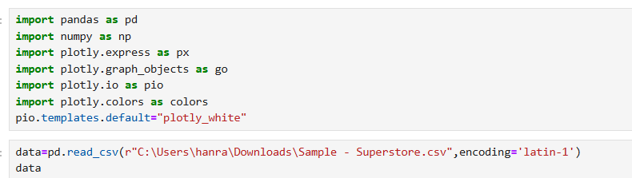
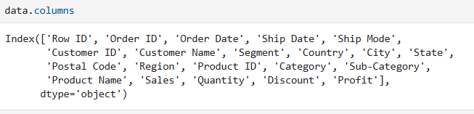
Data Collection
Imported the libraries in the Jupiter notes to upload the data
Imported the pandas for data manipulation and EDA purpose
Imported “ Plotly ” for data visualization
.
Checking for columns in the Dataset

Slide 5

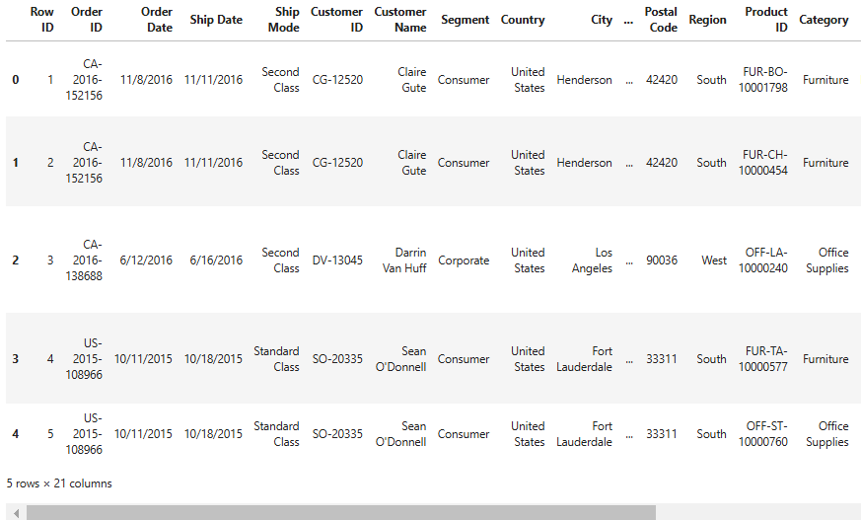
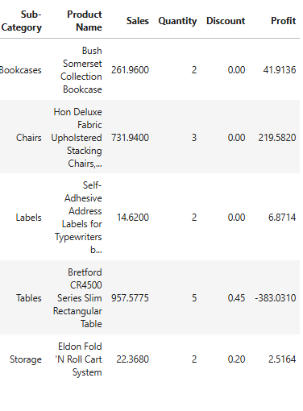
Checking for first five rows:

Slide 6
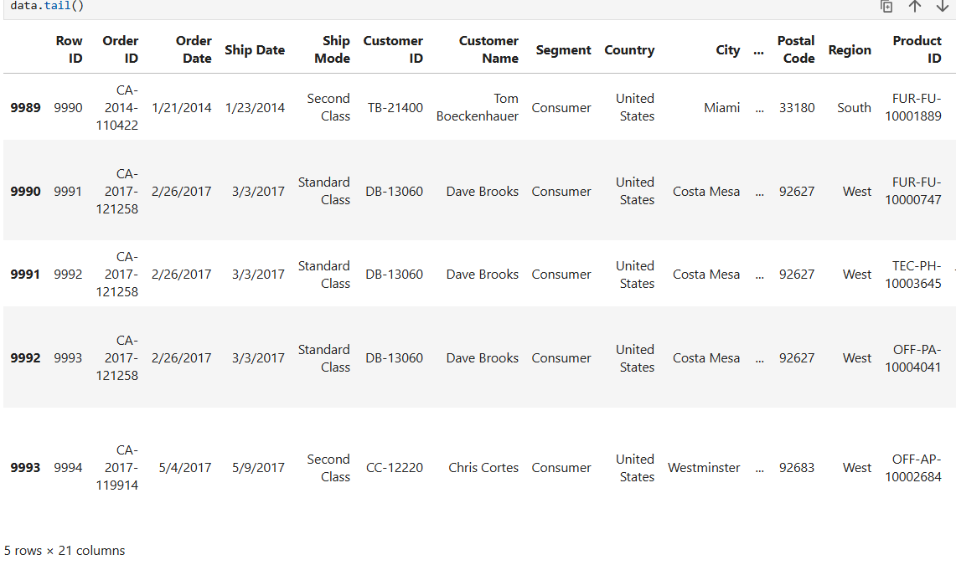
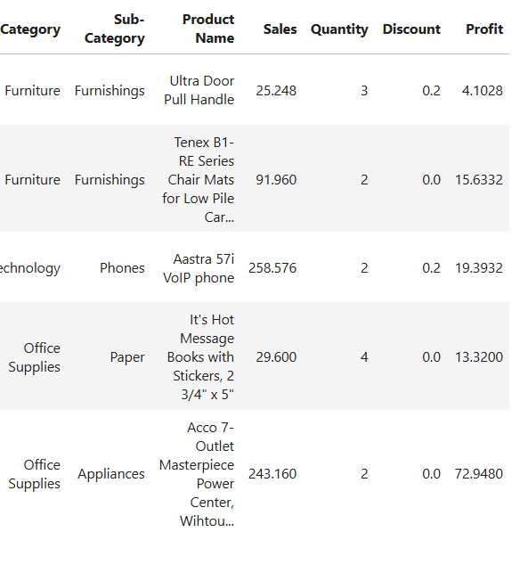
Checking for last five rows:

Slide 7
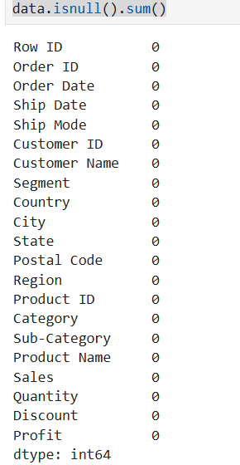
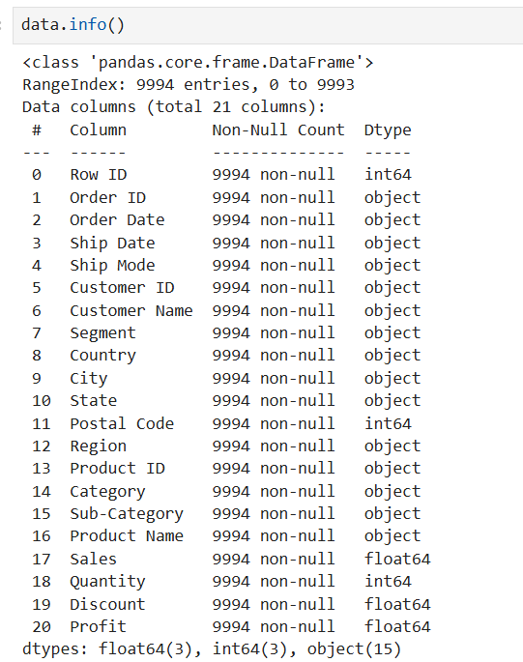

Checking for Null values:
No null values are found in the data set
But order Date and ship Date has object data type

Slide 8



Converting the date columns using
Now the data is updated
Data Preparation
Extracting the year Month and week of the orders
Now data is ready for exploratory process

Slide 9
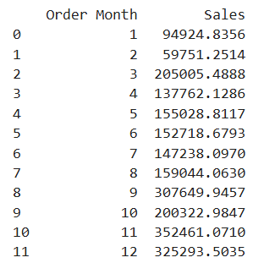
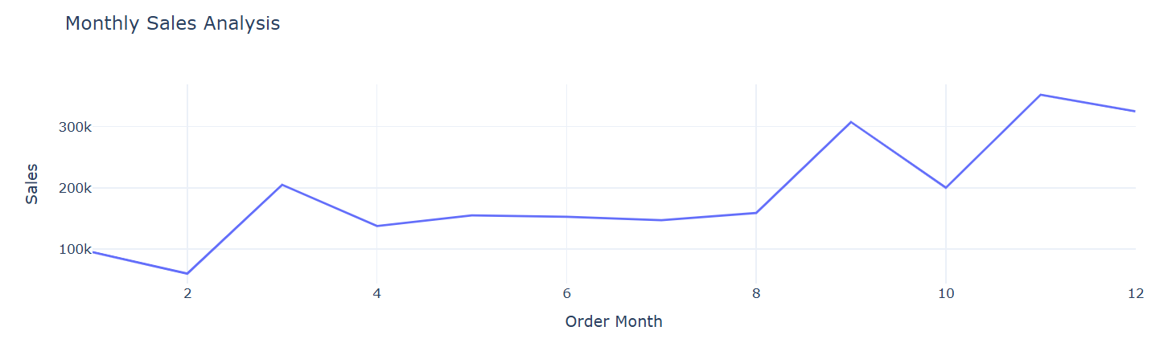
EDA
Monthly Sales

Slide 10

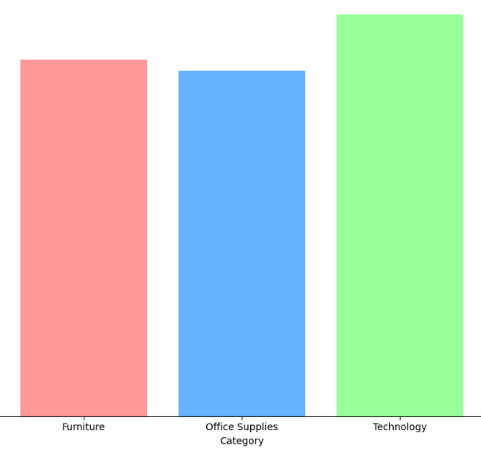
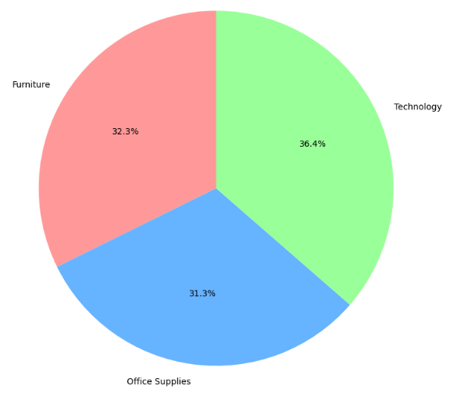
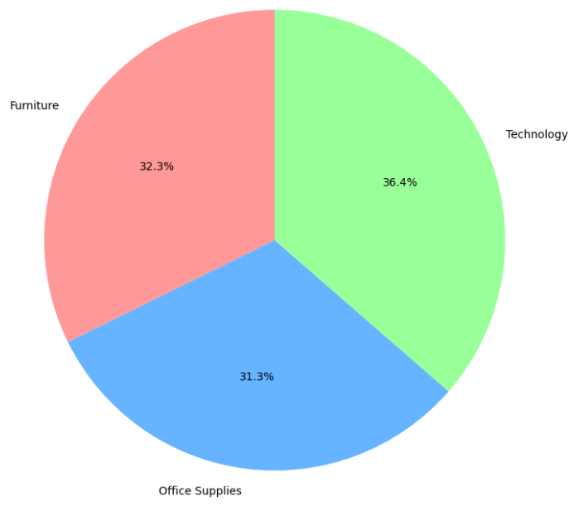
Sales by Category

Slide 11
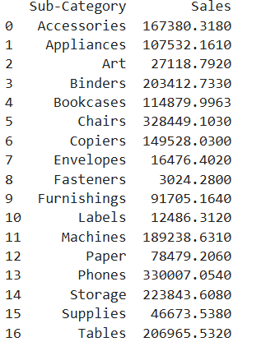
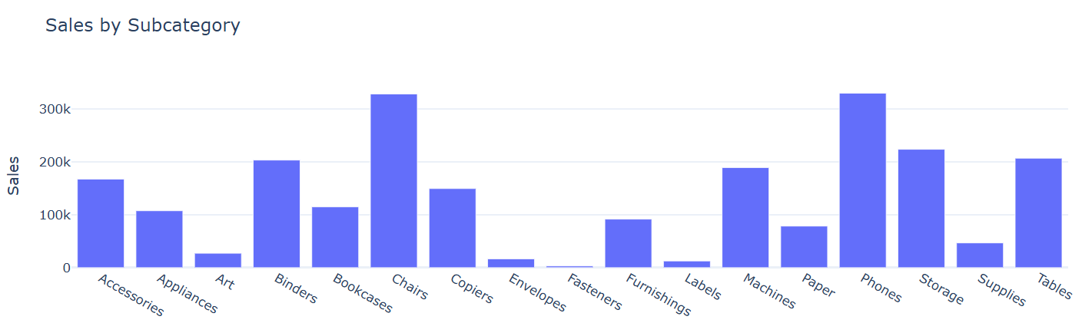
Sales by Sub category

Slide 12
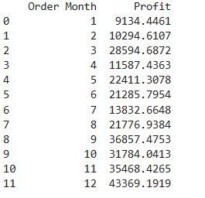
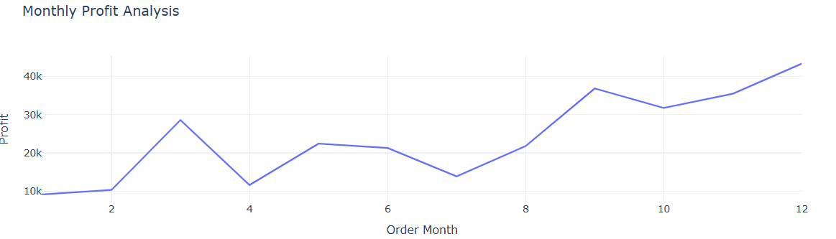
Profit by Month

Slide 13
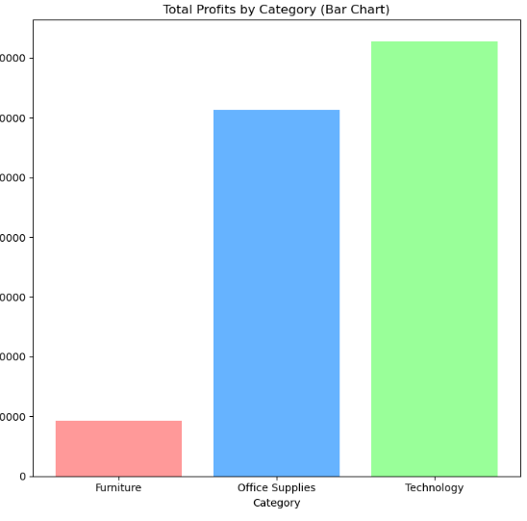

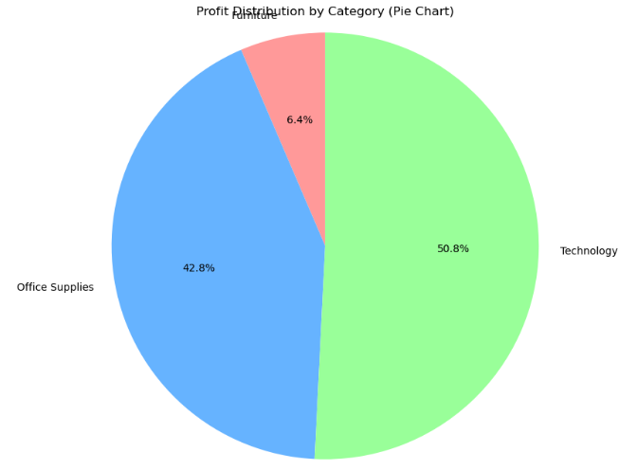
Profit by Category

Slide 14
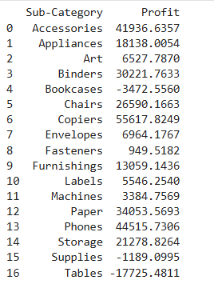
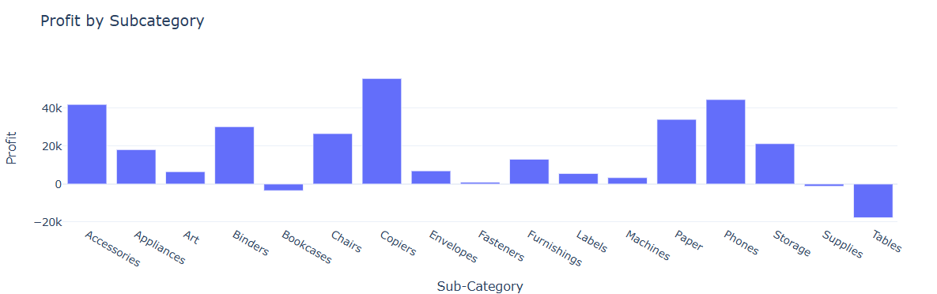
Profit by Sub Category

Slide 15
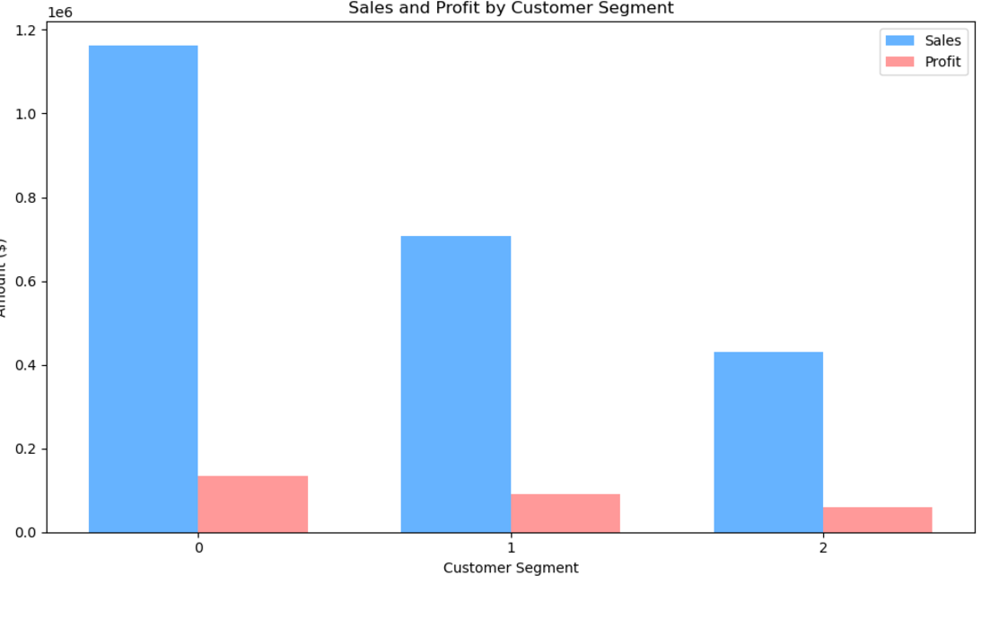

Sales and Profit by customer Segment

Slide 16
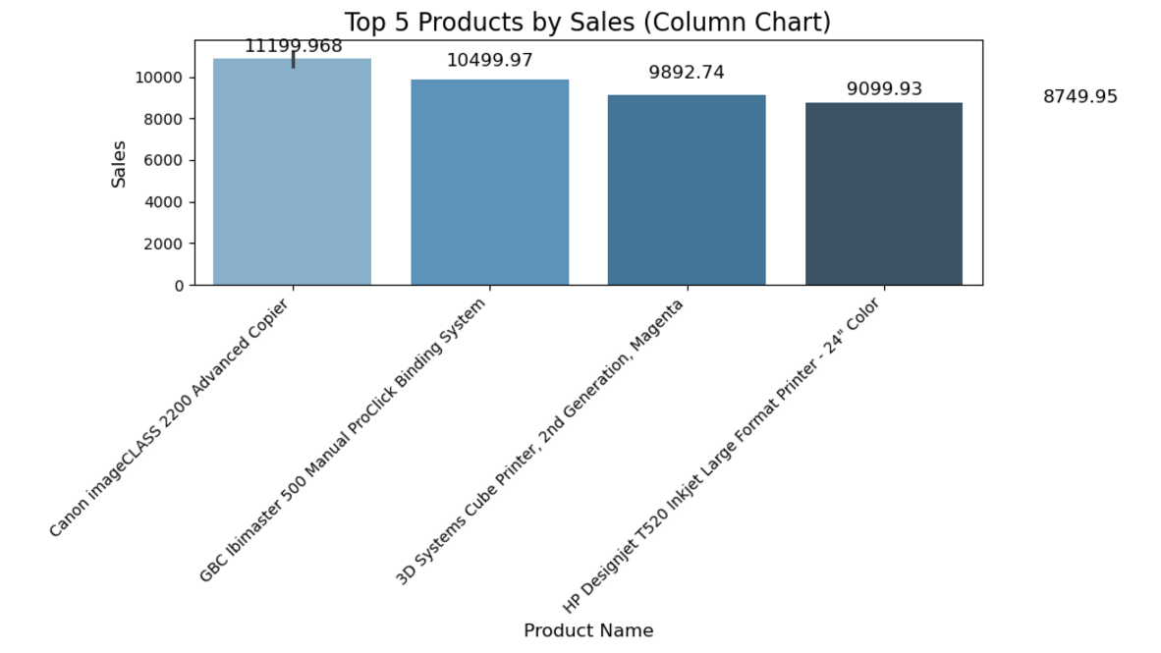

Sales profit Ratio by Segment
Top 5 Sales by products

Slide 17
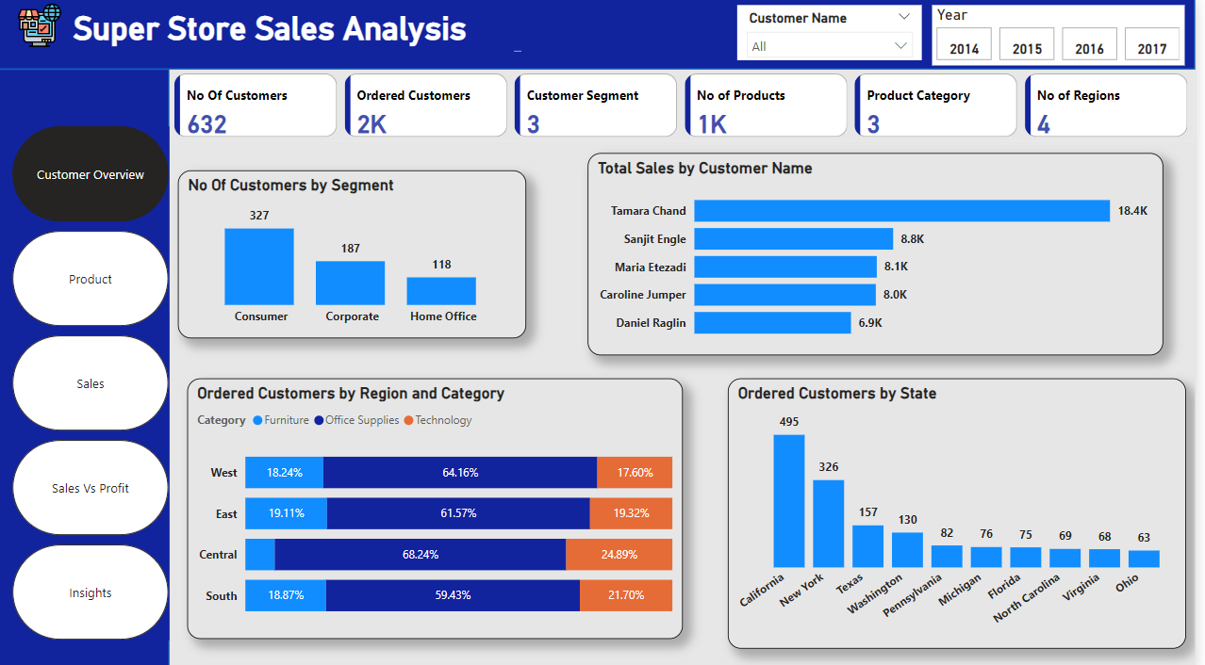
Dashboards With Power BI

Slide 18
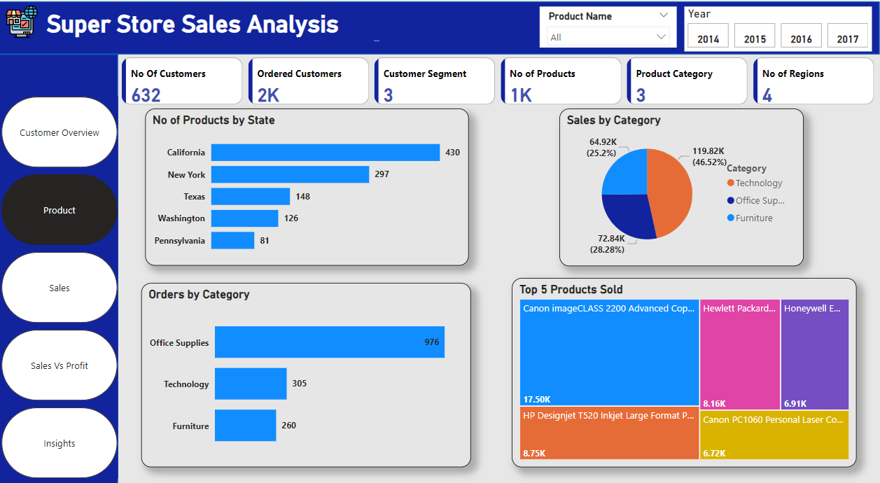

Slide 19
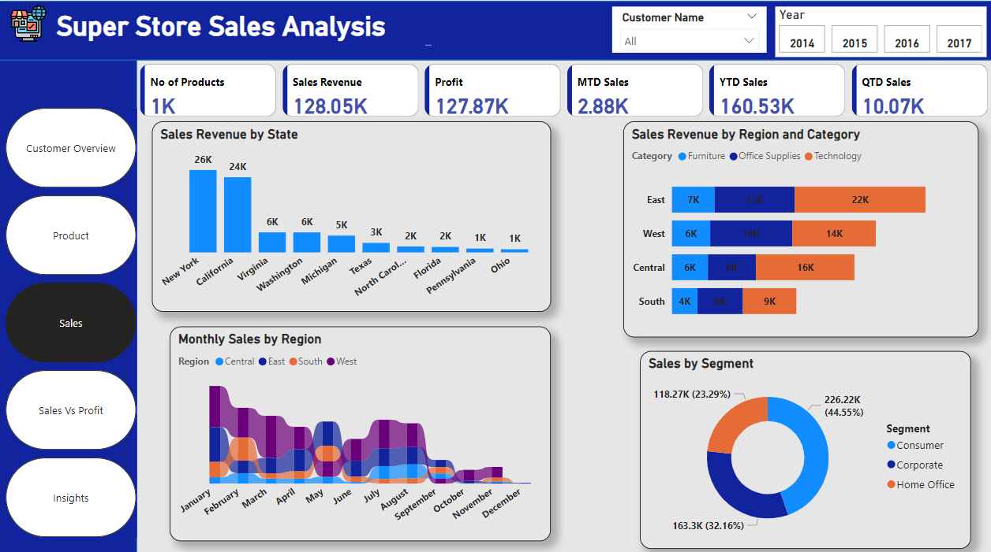

Slide 20
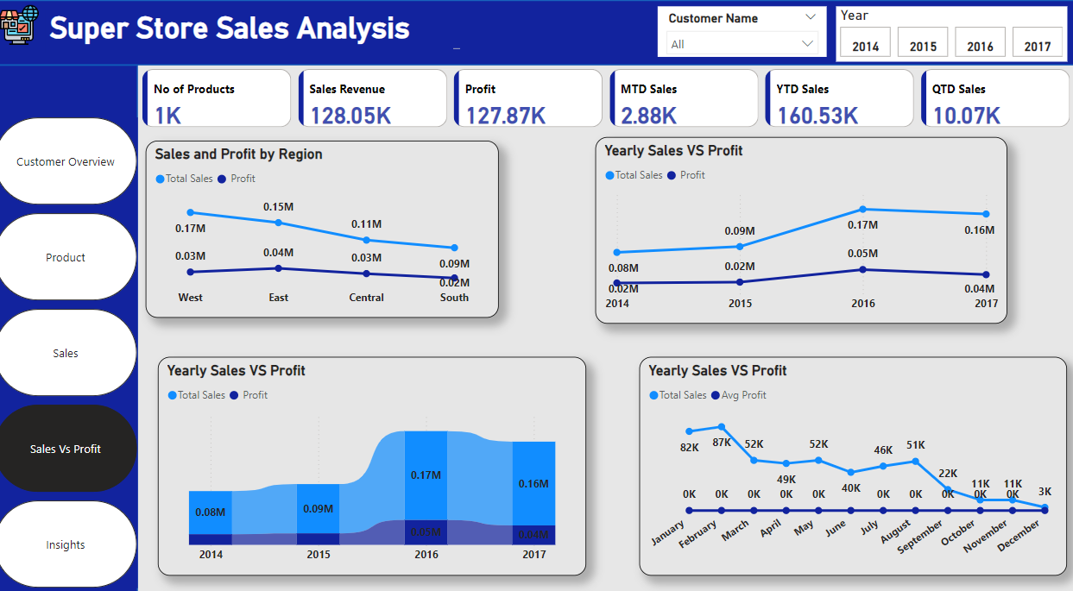

Slide 21
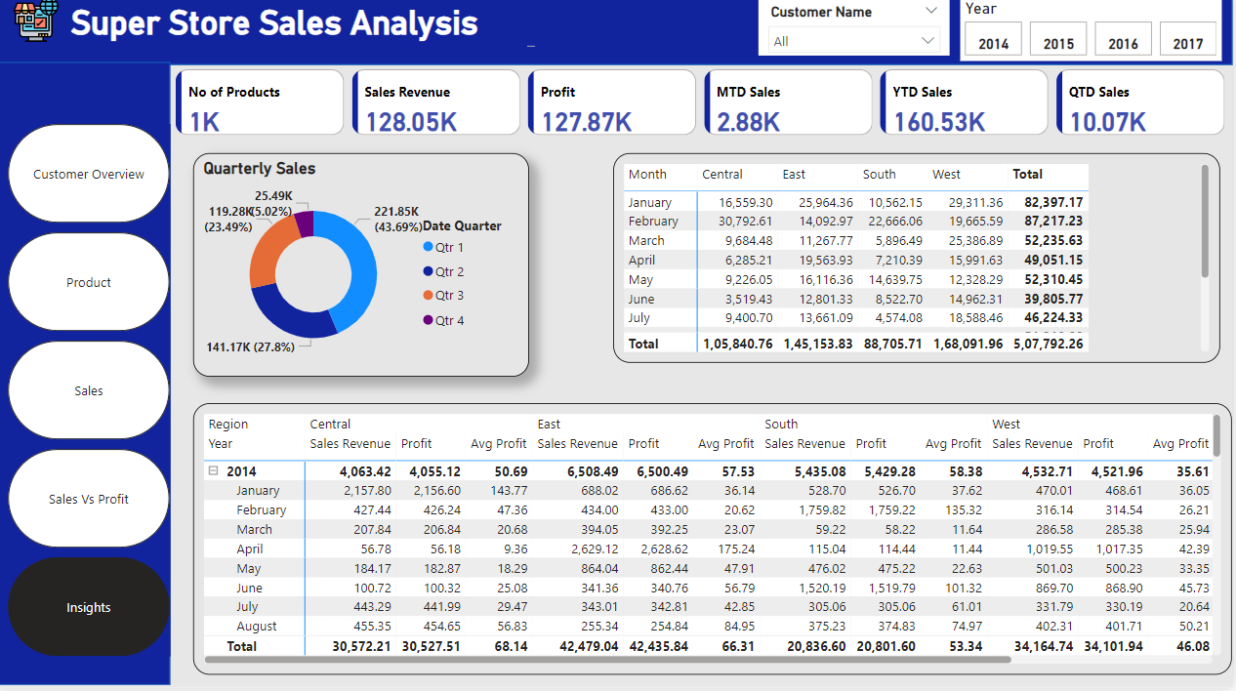

Slide 22
Insights:
Customer Insights:
Key Finding: The Consumer segment leads with the highest number of customers (327), 177.12% higher than the Home Office segment (118).
Recommendation: Given the strong performance of the Consumer segment, there is an opportunity to further engage this group with personalized marketing campaigns, loyalty programs, and targeted promotions to drive repeat business. Additionally, expanding the Home Office segment through targeted outreach could help balance customer distribution.
Key Finding: Office Supplies had the highest number of ordered customers (976), followed by Technology (305) and Furniture (260).
Recommendation: Focus on strengthening the product offerings in Office Supplies, ensuring availability during peak demand periods. For Furniture and Technology, consider bundling products to increase sales or offering seasonal discounts to boost demand.
Product Insights:
Key Finding: California had the highest number of products sold (430), outpacing Pennsylvania at 81 by 430.86%.
Recommendation: Since California is a high-performing state, consider running region-specific promotions and marketing campaigns to further capture its large customer base. For underperforming states like Pennsylvania, targeted outreach or localized offers could help boost product sales.
Key Finding: Office Supplies accounted for 63.34% of total orders.
Recommendation: Given the dominance of Office Supplies, consider diversifying the product range within this category to include high-demand sub-categories, such as eco-friendly options or premium products, to cater to changing customer preferences.

Slide 23
Sales Insights:
Key Finding: The West region generated the highest total sales at $144,303.93, followed by the East, South, and Central regions.
Recommendation: The West region shows the highest sales potential, so investing in regional marketing campaigns, increasing stock availability, and ensuring high visibility of top-selling products could further drive sales. Additionally, East and South regions should receive more targeted attention to close the gap in sales performance.
Key Finding: New York accounted for 34.01% of total sales revenue.
Recommendation: New York is a powerhouse for sales, and increasing marketing spend or exclusive product launches in the state could help maximize its already strong position. For other states with lower sales, focus on customized outreach to target regional customer preferences.
Profit Insights:
Key Finding: West region again led in total profit with $29,747.82, followed by East, South, and Central.
Recommendation: Similar to sales, prioritize profit-maximizing strategies in the West region by focusing on high-margin products, improving inventory management to avoid stock-outs, and ensuring efficient pricing. For other regions, assess opportunities for cost optimization and targeted promotions to drive up profitability.
Key Finding: New York contributed to 34.06% of the total profit.
Recommendation: Leverage New York’s profitability by continuing to invest in its growth, whether through improved customer service, exclusive deals, or expanding product availability in high-margin categories.

Slide 24
Quarterly Sales Insights:
Key Finding: Qtr 1 had the highest sum of sales at $221,850.03, making up 43.69% of total sales.
Recommendation: Qtr 1 has proven to be a peak period for sales, so consider ramping up marketing campaigns, running seasonal promotions, and ensuring stock levels are optimized for this quarter. Similarly, increase inventory forecasts for Qtr 1 next year to handle expected demand.
Key Takeaways & Strategic Recommendations:
Focus on High-Performing Segments: The Consumer segment and New York show strong performance. Invest in strategies to maintain and grow these segments, while exploring opportunities to elevate the underperforming Home Office segment.
Regional Strategy: Given the high performance of the West region, regional strategies like targeted promotions, better stock allocation, and personalized marketing can drive further growth. However, don’t neglect underperforming regions (e.g., East and South), where tailored outreach can boost sales.

